Slide 1
Church Mediation Training TennesseeMinistries
April 30th, 2016, Grace Place, Hermitage, Tennessee

Slide 2
WELCOME TO THIS CRUCIAL TRAINING
First of all, introductions-your name, and one thing about you that you don’t think anyone else in this room knows.

Slide 3
HERE IS WHAT WE ARE TALKING ABOUT:
“How can we help people have extraordinary conversations that can lead to extraordinary relationships?”
In other words, “How can we help people live at peace with God and each other through Christ?”

Slide 4
Three goals for this day:
1. First, that you will experience comfort and safety while talking about conflict during these next few hours.
2. Second, that you will discover at least two Scriptures which will help you deal with conflict.
3. Third, that you will learn two specific processes for: (1) dealing with personal, or individual conflict; and (2) for dealing with group conflict.
And a bonus goal: that we will all memorize Matthew 5:9, “Blessed are the peacemakers for they shall be called sons of God.”

Slide 5
There are three parts to this training:
1. Defining it (conflict).
2. Refining it.
3. Stepping into it (that is why I now where boots).

Slide 6
First, Bible Study and Prayer
Revelation 2:1-7; 2 Corinthians 5:11-21
Prayer

Slide 7
1. Defining it
What is conflict? What do you think of when you think of conflict?
What is the cost of conflict?
Chinese character for conflict means: crisis and opportunity.
We are familiar with the crisis in conflict, but what is our opportunity?

Slide 8
2. Refining it.
Read James 4:1-12; Galatians 5:13-15. Where does conflict come from and what is the outcome?
What have we been given as believers? Check out 2 Corinthians 5:11-21.
So why should we confront conflict in relationships and in the church?

Slide 9
10:00-B-B-R-R-E-E-A-A-A-K-K-K-K!!
BREAK TIME!?

Slide 10
3. Stepping into it.
Sooooo….what do you do when your State Pastor, or other State leader/Credentials member gives you a call and asks if you are available, willing, and just crazy enough to “step into it” and help a church work through a conflict situation>

Slide 11
P.A.U.S.E.
P-prepare
A-affirm relationships
U-understand interests
S-search for creative solutions
Evaluate options objectively and reasonably.

Slide 12
G.O.S.P.E.L.
G-greetings and ground rules
O-opening statements
S-story telling (what’s going on)
P-problem identification (what are the real issues)
E-explore options and solutions
L-leading to possible agreement

Slide 13
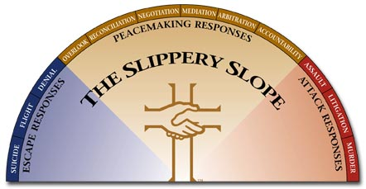
Peacemaker Principles Brochure

Slide 14
Let’s take a look at how Philippians could help us walk through conflict:
Remembering-Philippians 1:3-6
Refocusing-Philippians 2:1-5; :6-18
Re-igniting-Philippians 3:10-17
Rejoicing-Philippians 4:2-10

Slide 15
Here are five takeaways
1. Conflict is devastating to Christ’s Church-witness, relationships, stewardship.
2. Conflict starts in your heart (Matthew 7:1-5; ER Mgr. illustration)
3. Conflict is a matter of crisis and opportunity.
4. We are ambassadors of and for Christ. 2 Cor. 5:11-21.
5. Experience the power of the words from James, “Everyone should be quick to listen, slow to speak, and slow to become angry, for man’s anger does not bring about the righteous life that God desires.” -James 1:19,20

Slide 16
SESSION 2: PREVENTION AND INTERVENTION
Bible Reflection and Prayer-Philippians 4:2,3; 1 Corinthians 6:1-11

Slide 17
DEEP DIVE INTO MEDIATION: PREVENTION AND INTERVENTION
In PREVENTION we talk about accountability and trust.
In INTERVENTION we look at how the process proceeds from start to finish.

Slide 18
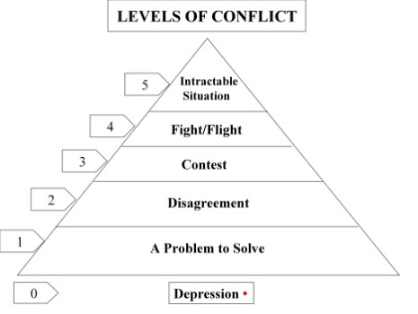
Five Levels of Conflict according to Speed Leas

Slide 19
POINTS OF PREVENTION
1. Prevention happens best at levels I and II.
2. Prevention happens as a church determines how they will deal with conflict.
3. Prevention happens through clear accountability and trust

Slide 20
INTERVENTION
“The Circle Process”
Review the G.O.S.P.E.L. process
A quick look at Philippians as a process for intervening

Slide 21
The Intervention
Acknowledge
Assess
Action
Agreement

Slide 22
What if….
1-First, how binding is the mediation agreement?
2-what if there is no agreement?
3-what if someone breaks the agreement
4-what if we get stuck or reach an impasse?

Slide 23
Additional Questions
1-When do Christians call on a Mediator? How is a Mediator chosen?
2-How do we deal with difficult people?
3-Who has your “blind side?”

Slide 24
What are some legal issues and questions:
1-Should Christians go to court?
2-What is informed consent and how does it help?
3-Should attorneys be involved in a legal dispute between Christians and if so, then how?
4-Should attorneys be allowed to advise or represent a group in official church business meetings?
5-

Slide 25
As we close, can we sing, “Near the Cross”
Jesus, keep me near the cross, There a precious fountain— Free to all, a healing stream— Flows from Calv’ry’s mountain.
Refrain: In the cross, in the cross, Be my glory ever; Till my raptured soul shall find Rest beyond the river.

Slide 26
Near the cross, a trembling soul, Love and Mercy found me; There the bright and morning star Sheds its beams around me.
Near the cross! O Lamb of God, Bring its scenes before me; Help me walk from day to day, With its shadows o’er me.

Slide 27
Near the cross I’ll watch and wait Hoping, trusting ever, Till I reach the golden strand, Just beyond the river.
From <http://library.timelesstruths.org/music/Near_the_Cross/>

